Slide 1
The Science of Energy

Slide 2
What is Energy?
Energy is broadly defined as the ability to do work
It is the property of a substance, object or material that allows it to do work
Energy is classified into two major categories: potential and kinetic

Slide 3
Potential Energy
Potential energy is either due to stored energy in the object or substance or to the position of the object
How do these objects store potential energy?
Battery
Auto suspension spring
Water tower
Sugar

Slide 4
Potential Energy
A battery contains chemicals which react to release electrons
A spring that is compressed or stretched stores mechanical potential energy
Water at a height has gravitational potential energy due to its position
Sugar contains chemicals that react with chemicals in your body to produce energy

Slide 5
Potential Energy
Type | Properties | Where it is found
Chemical | Energy stored in the bonds of molecules and atoms | Coal, petroleum, natural gas, food, biomass
Gravitational | Energy stored in an object’s height | A dam holding back water at a hydroelectric plant; a person standing at the top of a ski slope
Mechanical | Energy stored in objects as tension | Springs, rubber bands
Nuclear | Energy stored in the bonds that hold the nucleus of an atom together | Uranium, plutonium

Slide 6
Kinetic Energy
Kinetic energy is the energy of motion--of waves, electrons, atoms, molecules, substances, and objects

Slide 7
Kinetic Energy
Type | Properties | Where it is Found
Motion | Energy stored in the movement of objects; The faster they move, the more energy is stored. | It takes energy to get an object moving, and energy is released when an object slows down..Wind
Electrical | Delivered by charged particles—electrons—usually flowing through a wire | Lightning, static discharge, electricity flowing through residential wiring
Sound | The movement of energy through substances in longitudinal waves. | Produced when a force—like a drumstick— causes an object or substance to vibrate — like a drum head; the energy is transferred through the drum head in a wave and then through the air as a wave
Thermal | Heat; the vibration of molecules within atoms and molecules of substances | Geothermal energy of the earth
Radiant | Electro magnetic energy that travels in transverse waves | Visible light, x-rays, gamma rays, radio waves, sunlight

Slide 8
The Scientific Law of Conservation of Energy
Energy is neither created nor destroyed
It can only be transformed from one form to another

Slide 9
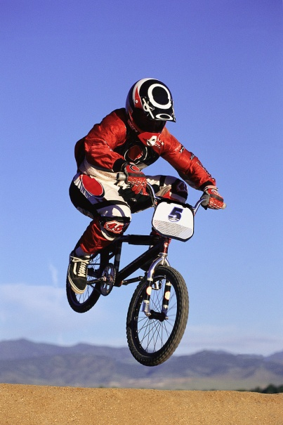
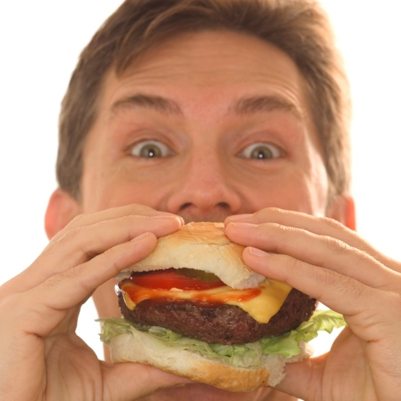
What kind of energy is being transformed? What is it being transformed into?
Chemical energy
Motion

Slide 10
What kind of energy is being transformed? What is it being transformed into?
Radiant Energy
Chemical Energy

Slide 11
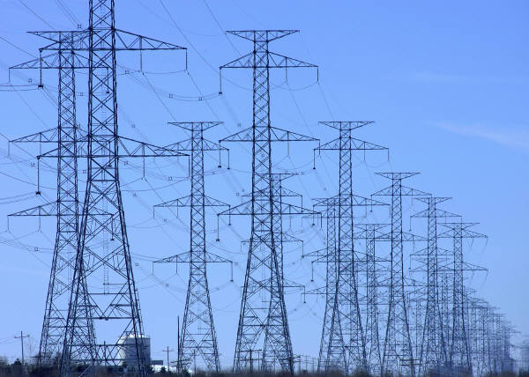
What kind of energy is being transformed? What is it being transformed into?
Electrical energy
Thermal Energy

Slide 12
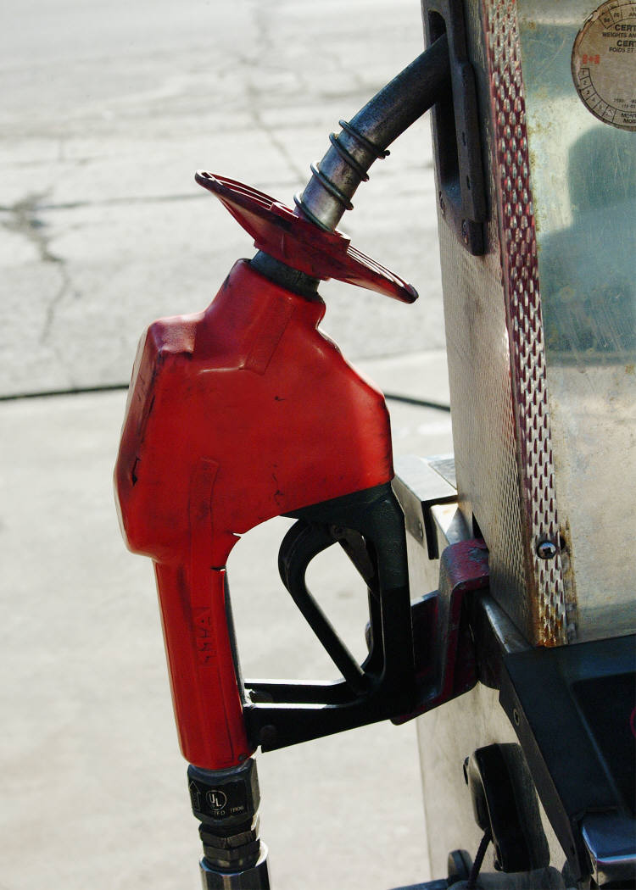
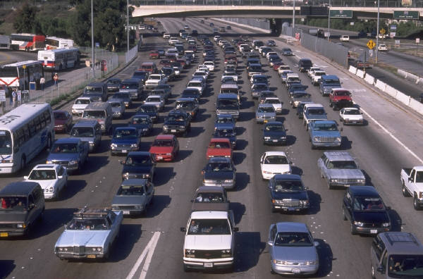
What kind of energy is being transformed? What is it being transformed into?
Chemical energy
Motion

Slide 13
For More Information
Energy Explained: Your Guide to Understanding Energy http://www.eia.doe.gov/energyexplained/

